Slide 1
Male vs Female

Slide 2
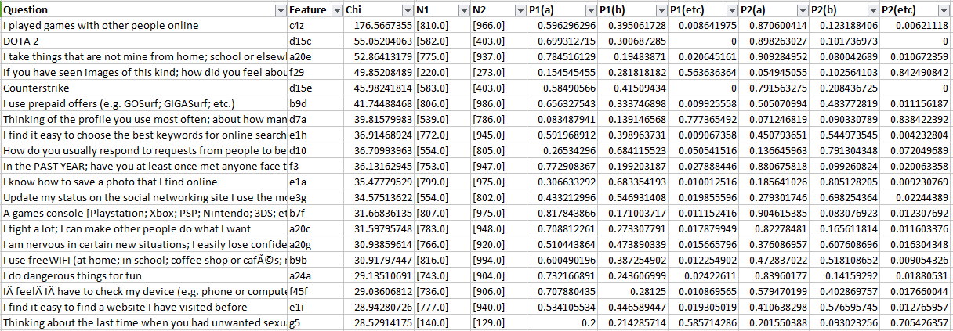

Slide 3

OOTO Information Miner
99% Confidence interval χ2
PHILIPPINES
 | Male |  |  | Female
 | a | b | etc | a | b | etc
A14: How often do you get some new clothes to wear? | 11% | 86% | 3% | 6% | 91% | 3%
A18: Do you have at least two pairs of properly fitting shoes? [include: boots; sandals; trainers; etc.] | 19% | 79% | 2% | 11% | 88% | 0%
A19: How often do you get some new games or toys to play with? | 51% | 44% | 5% | 55% | 37% | 8%
Note:
a = Hardly ever/No
b = Once or twice a year/Every few months/Every few weeks/Yes
etc = Prefer not to say
Notes:
Simple Questions
It’s a table

Slide 4
OOTO Information Miner
99% Confidence interval χ2
PHILIPPINES
A20: Please tell me how true are the following things for you? | Male |  |  | Female
 | a | b | etc | a | b | etc
A20a: I get very angry and often lose my temper | 41% | 58% | 1% | 31% | 68% | 1%
A20c: I fight a lot; I can make other people do what I want | 71% | 27% | 2% | 82% | 17% | 1%
A20d: I am often accused of lying or cheating | 67% | 32% | 1% | 74% | 24% | 2%
A20e: I take things that are not mine from home; school or elsewhere | 78% | 19% | 2% | 91% | 8% | 1%
A20f: I worry a lot | 33% | 66% | 2% | 24% | 75% | 1%
Note:
a = Not true for me
b = A bit/Fairly/Very true for me
etc = Prefer not to say
Notes:
Simple Questions
It’s a table

Slide 5
OOTO Information Miner
99% Confidence interval χ2
PHILIPPINES
A20: Please tell me how true are the following things for you? | Male |  |  | Female
 | a | b | etc | a | b | etc
A20g: I am nervous in certain new situations; I easily lose confidence | 51% | 47% | 2% | 38% | 61% | 2%
A20i: I am often unhappy; sad or tearful | 52% | 47% | 1% | 44% | 55% | 1%
A20j: I have many fears and I am easily scared | 41% | 58% | 2% | 31% | 67% | 1%
A20l: I finish the work I'm doing. My attention is good | 25% | 74% | 2% | 18% | 80% | 2%
A20u: I am helpful if someone is hurt; upset or feeling ill | 25% | 73% | 2% | 17% | 81% | 2%
A20v: I try to be nice to other people. I care about their feelings | 21% | 77% | 1% | 15% | 84% | 1%
A20w: I often volunteer to help others (e.g.; parents; carers; teachers; children) | 22% | 75% | 3% | 17% | 82% | 1%
A20x: I usually share with others (food; games; pens etc.) | 17% | 82% | 1% | 12% | 87% | 1%
Notes:
Simple Questions
It’s a table

Slide 6
OOTO Information Miner
99% Confidence interval χ2
PHILIPPINES
A22: Why do you think you are being mistreated? | Male |  | Female
 | a | b | a | b
A22c: Because of my religion | 86% | 14% | 92% | 8%
A22g: Because of my sexual orientation | 93% | 7% | 97% | 3%
A22m: Due to conflict / war in our area | 96% | 4% | 99% | 1%
A22n: Because I am not studying (i.e.; out-of-school) | 95% | 5% | 98% | 2%
Note:
a = No
b = Yes
Notes:
Simple Questions
It’s a table

Slide 7
OOTO Information Miner
99% Confidence interval χ2
PHILIPPINES
 | Male |  |  | Female
 | a | b | etc | a | b | etc
A24a: I do dangerous things for fun | 73% | 24% | 2% | 84% | 14% | 2%
A24b: I do exciting things; even if they are dangerous | 71% | 27% | 2% | 81% | 17% | 2%
A25a: I had so much alcohol that I got really drunk | 88% | 10% | 2% | 94% | 4% | 2%
A25b: I missed school lessons without my parent(s)/carer(s) knowing | 82% | 17% | 2% | 89% | 9% | 2%
A25f: Met personally with someone whom I met online (i.e.; eyeball) | 84% | 14% | 2% | 91% | 8% | 1%
Note:
a = Not true/No
b = A bit true/Very true/Yes
etc = Prefer not to say
Notes:
Simple Questions
It’s a table

Slide 8
OOTO Information Miner
99% Confidence interval χ2
PHILIPPINES
 | Male |  |  | Female
 | a | b | etc | a | b | etc
G1b: I opened a message or a link in a message that showed pictures of naked people or of people having sex that I did not want | 86% | 12% | 2% | 92% | 7% | 2%
G5: Thinking about the last time when you had unwanted sexual experience (that is; any of G2a-d); who was the person who did this? | 20% | 21% | 59% | 20% | 9% | 71%
G9a: Thinking about the last time when you had unwanted sexual experience; did you tell your brother (over 18) about it? | 73% | 27% | 0% | 86% | 14% | 0%
H2c: When you are bored or upset, do you talk to a friend around your age? | 66% | 34% | 0% | 58% | 42% | 0%
H2g: When you are bored or upset, do you talk to someone else about it? | 96% | 4% | 0% | 98% | 2% | 0%
H2h: When you are bored or upset, do you keep it to yourself? | 92% | 8% | 0% | 97% | 3% | 0%
Note: a = Not true/No b = A bit true/Very true/Yes etc = Prefer not to say
Notes:
Simple Questions
It’s a table

Slide 9
OOTO Information Miner
PHILIPPINES
Male vs Female
Notes:
Single Question

Slide 10
OOTO Information Miner
PHILIPPINES
Mining Experiments
Dataset 1 | # | Dataset 2 | # | #Significant Variables
Male | 872 | Female | 772 | 127
Age Group: 9-11 | 586 | Age Group: 12-14 | 656 | 134
Age Group: 12-14 | 656 | Age Group: 15-17 | 640 | 109
Age Group: 9-12 | 586 | Age Group: 15-17 | 640 | 212
Nation | 1882 | Sultan Kudarat | 74 | 14
(A20i) : Happy | 814 | (A20i): Sad | 877 | 262
(A17a) : Rarely eat meat or fish | 205 | (A17a) : Frequently eat meat or fish | 1492 | 85
Notes:
Mining Experiments
It’s a table

Slide 11
OOTO Information Miner
PHILIPPINES
Mining Experiments
Dataset 1 | # | Dataset 2 | # | #Significant Variables
Sultan Kudarat | 74 | Cavite | 96 | 5
Batangas | 87 | Cavite | 96 | 10
Sultan Kudarat | 74 | Batangas | 87 | 7
Nation | 1882 | Cavite | 96 | 50
Notes:
Mining Experiments
It’s a table

